Slide 1
Digital Portfolio
STUDENT NAME:V.VIGNESH
REGISTER NO AND NMID: 24131061802521094 025EC866BEDC52F87DA4C7BC414A161B
DEPARTMENT: BSC COMPUTER SCIENCE
COLLEGE: COLLEGE/ UNIVERSITY:SHREE RAGHAVENDRA ARTS AND SCIENCE COLLEGE KEEZHAMOONGILADI/ANNAMALAI UNIVERSITY

Slide 2
PROJECT TITLE
PORTFOLIO WEB PAGE

Slide 3


AGENDA
Problem Statement
Project Overview
End Users
Tools and Technologies
Portfolio design and Layout
Features and Functionality
Results and Screenshots
Conclusion
Github Link
3/21/2024 Annual Review

Slide 4

PROBLEM STATEMENT
1. Background/Context – What is the situation? 2. The Problem – What exactly is wrong or missing? 3. Impact – Why is it important to solve this? 4. Objective – What outcome do you want after solving it?

Slide 5

PROJECT OVERVIEW
Project Name/Title – A clear and descriptive name for your project. 2. Background/Context – Brief explanation of why the project is needed or what problem it solves. 3. Project Objectives – The main goals the project aims to achieve. 4. Scope – A summary of what’s included (and sometimes excluded) in the project. 5. Deliverables – What the project will produce (reports, systems, designs, products, etc.). 6. Timeline – High-level schedule or key milestones. 7. Stakeholders – Who is involved or impacted (team, customers, etc.). 8. Budget/Resources (Optional) – A rough idea of cost or resources needed

Slide 6

WHO ARE THE END USERS?
Provide real-time parking updates so I can plan ahead.Let me reserve and pay for spots easily through my phone.Make parking faster and stress-free by guiding me to my spot

Slide 7

TOOLS AND TECHNIQUES
Design and Layout1. Design Approach:Minimalistic & Clean: Simple color palette and modern fonts for a professional look.Consistent Theme: Uniform colors, typography, and spacing across all pages.Interactive Elements: Buttons, hover effects, and animations for better engagement.2. Layout Structure:Home Page: Personal intro with name, profession, and a brief tagline.About Section: Details about education, skills, and interests.Projects Section: Showcase of work with descriptions, images, and links.Skills Section: Technical and soft skills represented with icons or bars.Contact Section: Contact form and social media links.3. Responsive Design:Optimized for desktop, tablet, and mobile devices.Grid-based layout for consistent alignme

Slide 8
POTFOLIO DESIGN AND LAYOUT
Design -Simple dean, and professional look Consistent color scheme [ight/dark contrast Reodable fonts with proper sizing Layout HeaderName, sugine, navigation men About Section Profile pictum shott bin Projects Section Gnalcards shoncosing work
8

Slide 9
FEATURES AND FUNCTIONALITY
Features Clean, modern single-page design Responsive layout (mobile, tablet, desktop) About, Projects, and Contact sections Profile picture and short bio Functionality Navigation links scroll smoothly to sections Hover effects on buttons and project cards Form validation using JavaScript

Slide 10
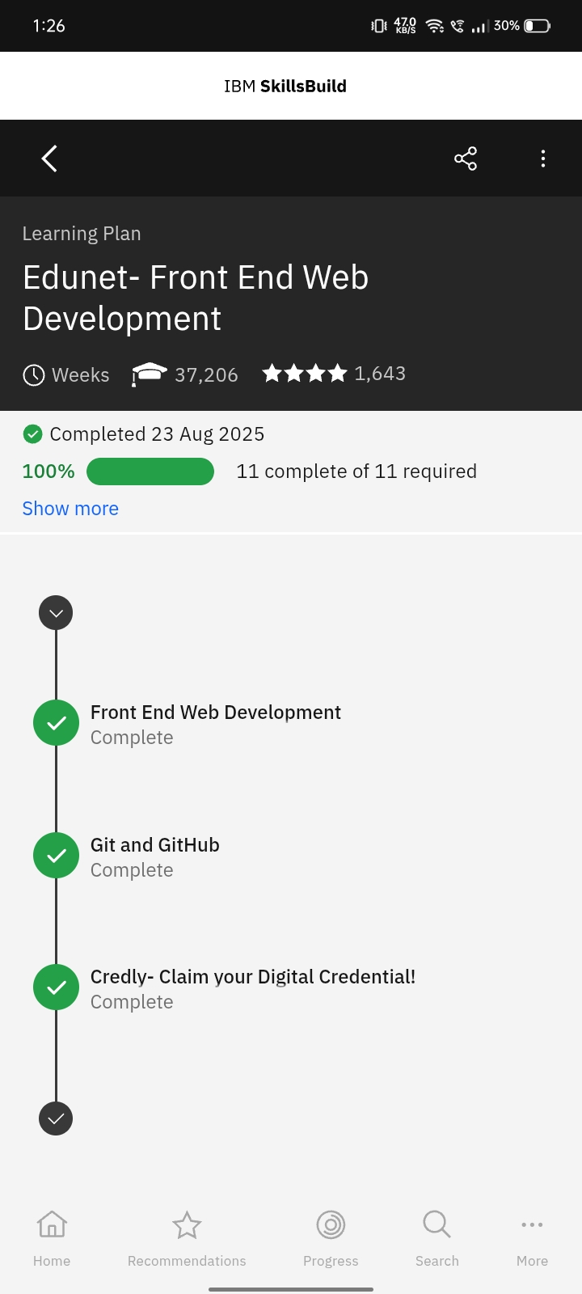
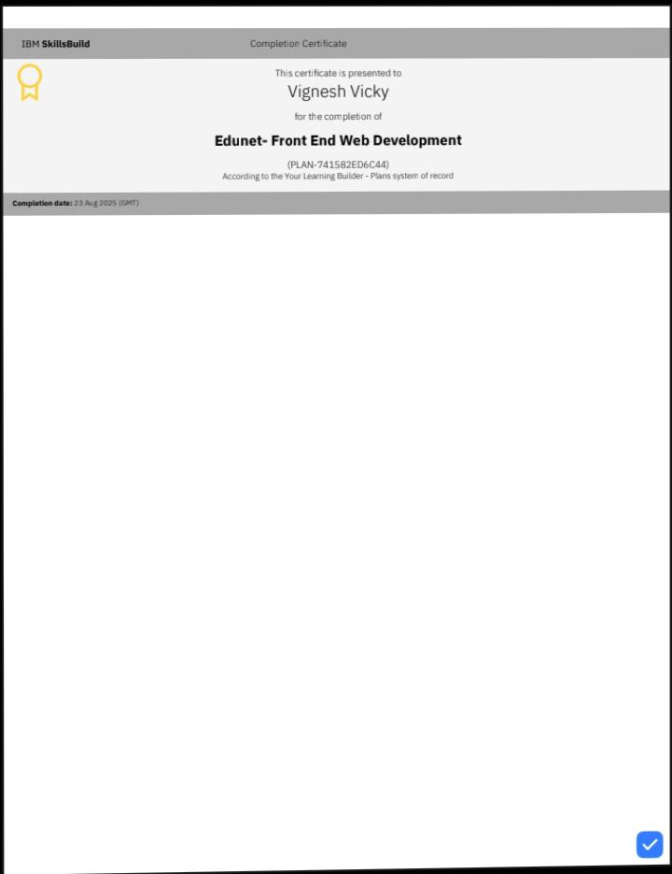
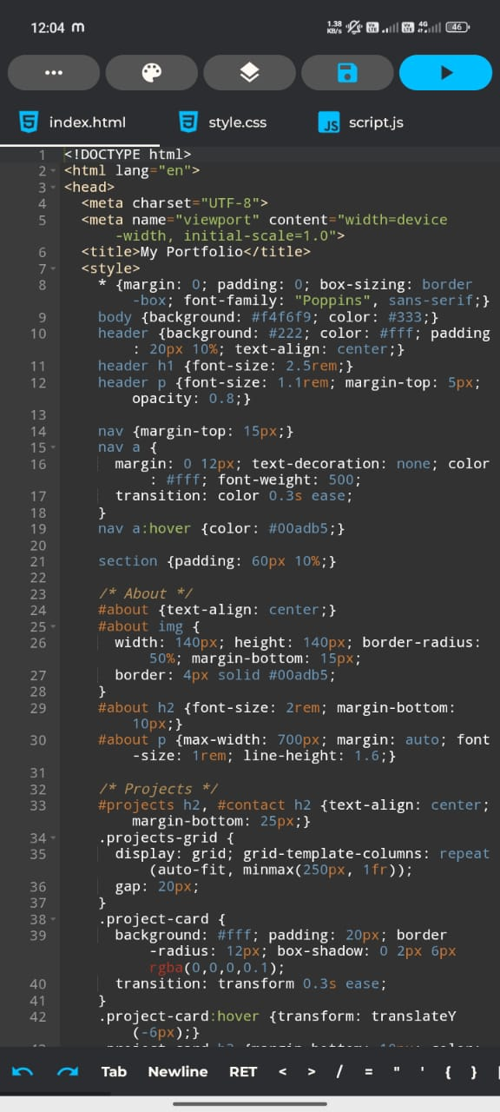

RESULTS AND SCREENSHOTS
3/21/2024 Annual Review
10

Slide 11
CONCLUSION
A responsive portfolio website was successfully developed. It effectively showcases profile, projects, and contact details. The design is surple, modem, and user-filendly.
11

